Slide 1
Classifying Higgs Boson Signals
Matthew Boyer Jonah Goldfine

Slide 2
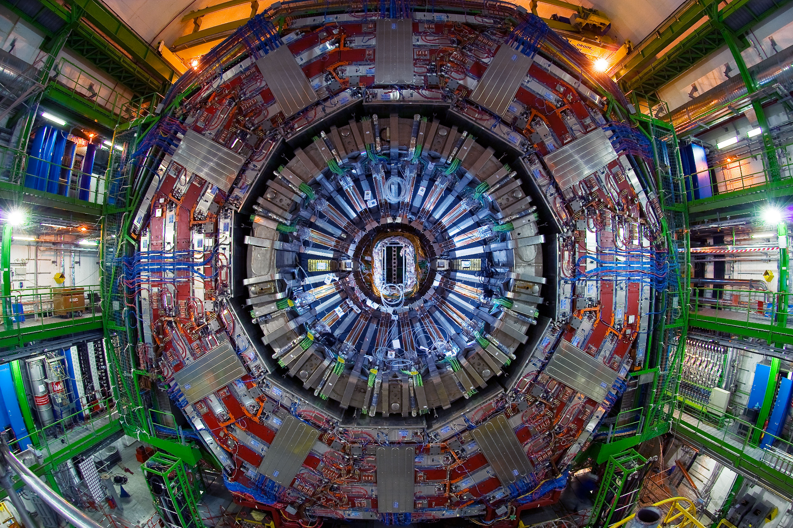
The Data

Slide 3
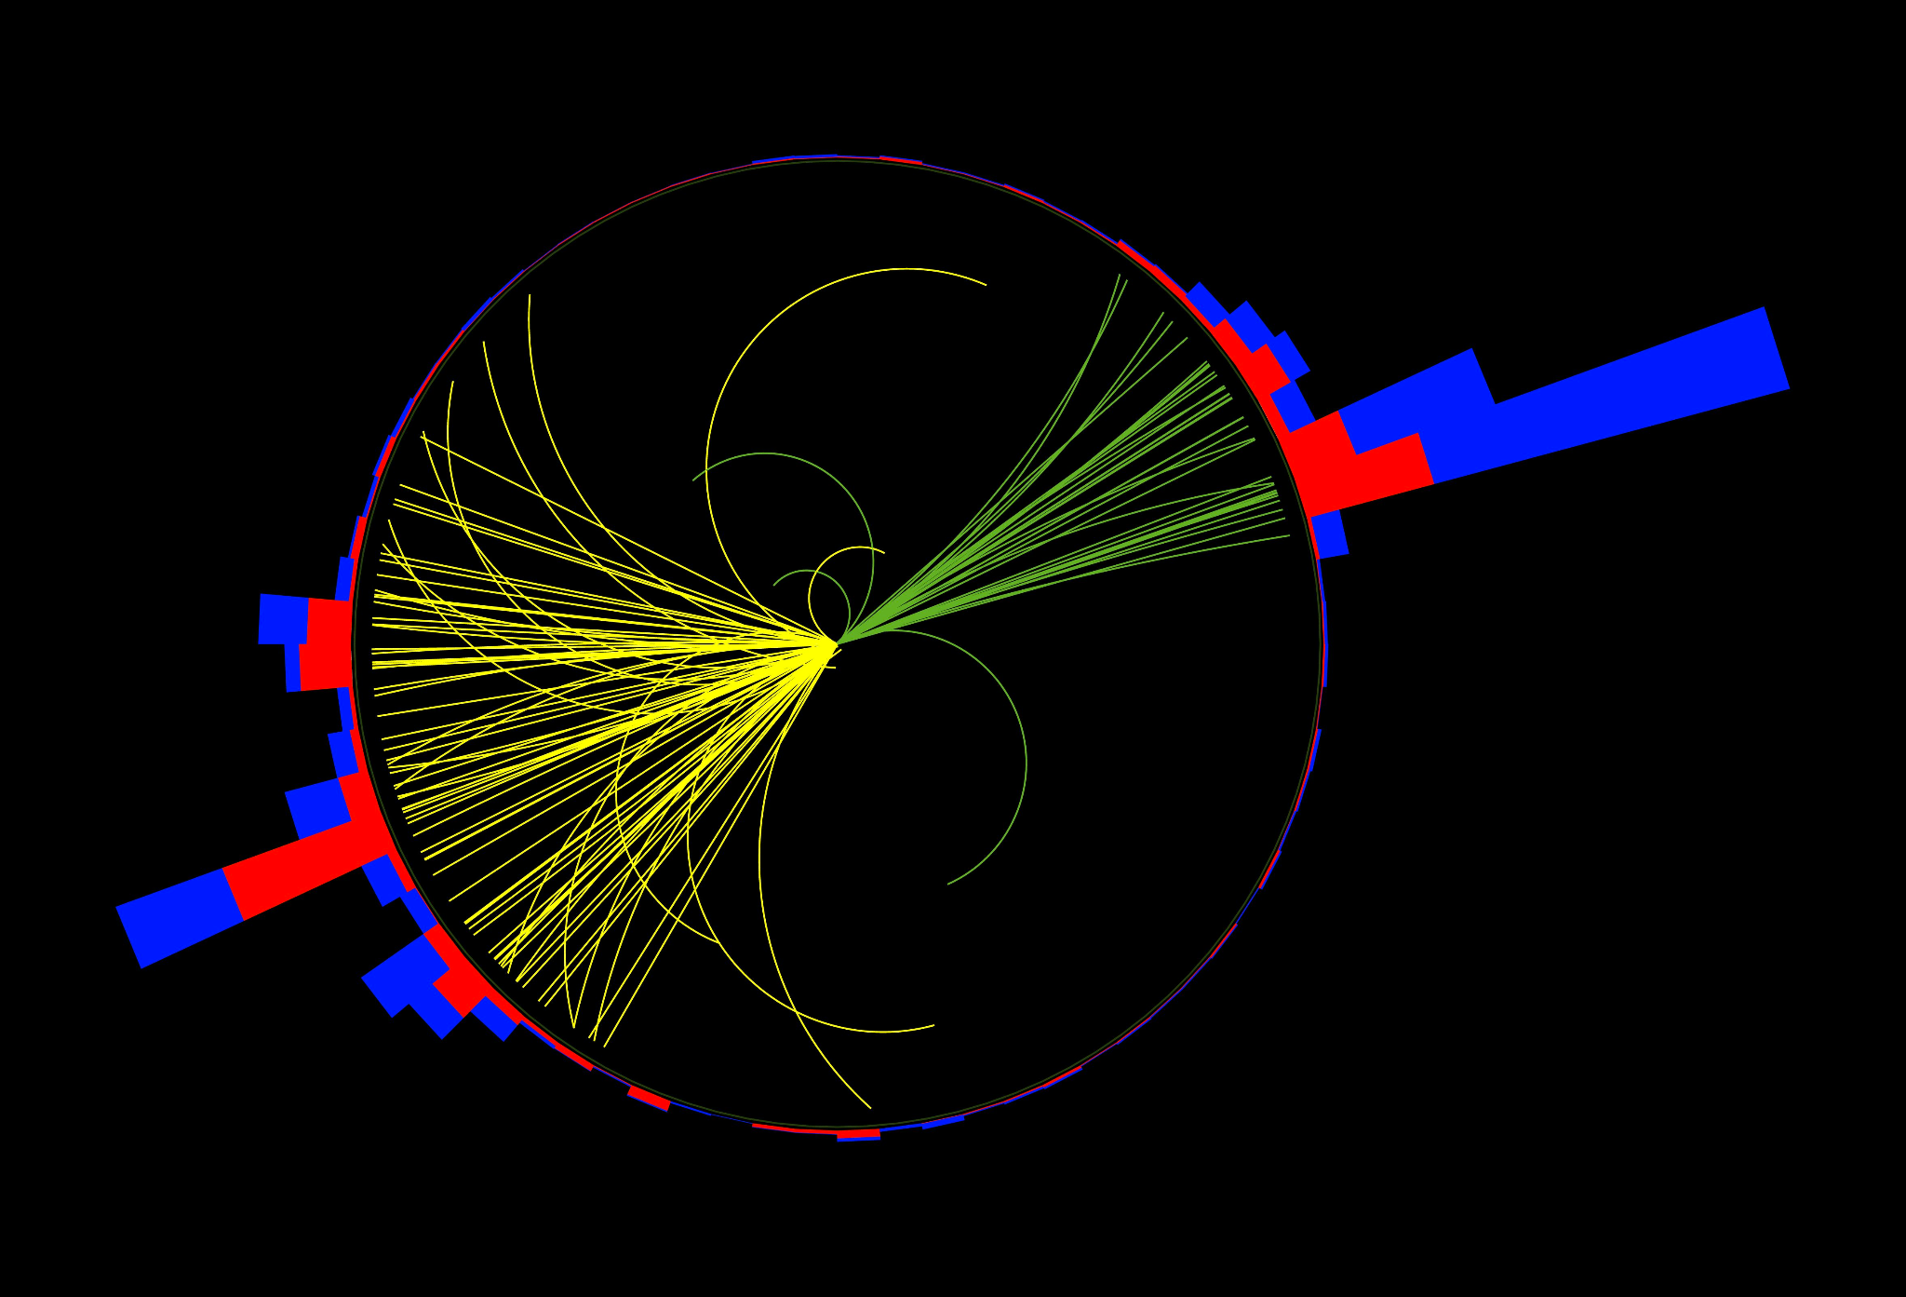
The Features
28 Features each representing a different value measure in proton-proton collision
16 related to jets
Per jet 3 of them are related to momentum and 1 is a tag related to whether or not the jet contains a heavy quark
3 related to the momentum of Leptons (electrons or muons)
7 different invariant mass distribution peaks
Different invariant mass peaks can be indicative different reactions occuring
2 related to the magnitude and direction of missing energy

Slide 4
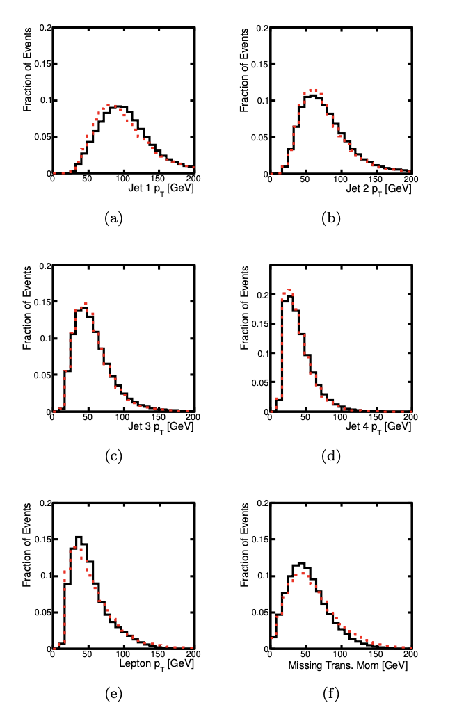
Data Normalization
Features are largely close to normal
Chose to use standard scalar
The is risk to this because some information is lost due to skews
Decision backed by the same decision in original paper

Slide 5
Other Models

Slide 6
The Original Models
Tested Boosted Decision Tree, Shallow NN, and Deep NN on Low-level, High-level, and complete features
Paper created a few DNNs using PyLearn2 each model having varying number of layers
Use ROC AUC to compare models
Best performing DNN model has AUC of 0.895
Authors developed similar models for Supersymmetry Particles
Some of these models included dropout

Slide 7
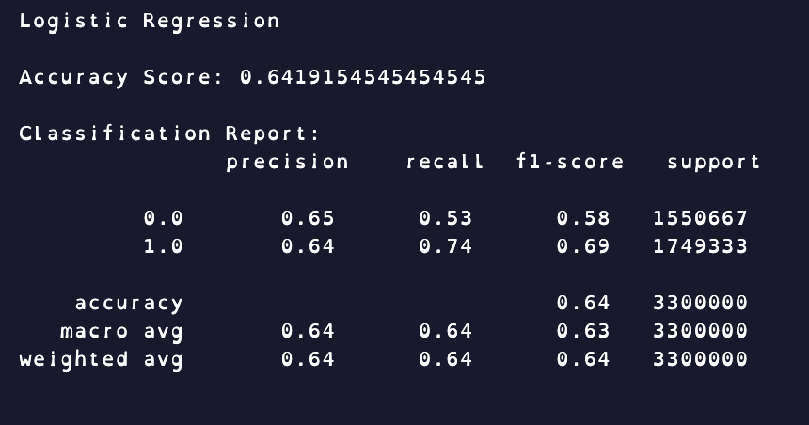
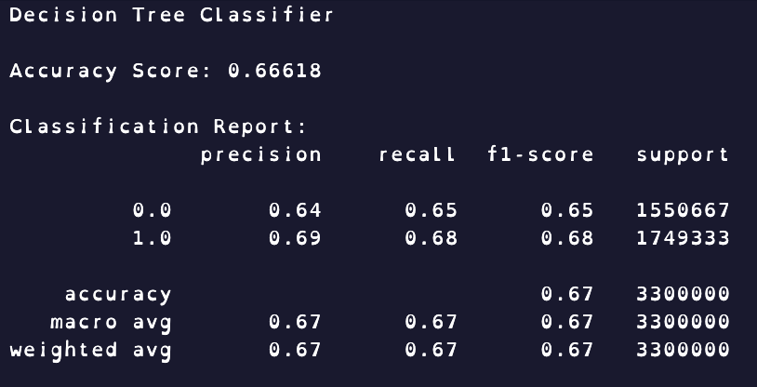
Our Other Models
We also tested Decision Tree Classifier and Logistic Regression
Both did similarly mediocre

Slide 8
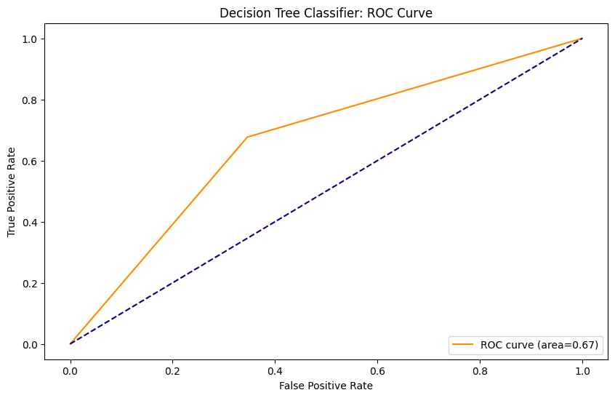
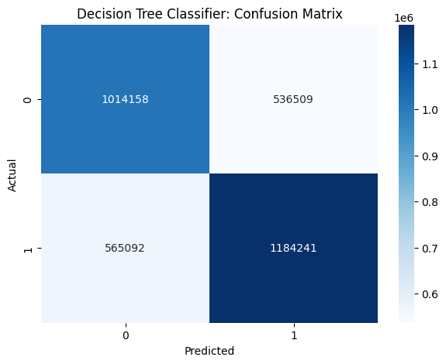
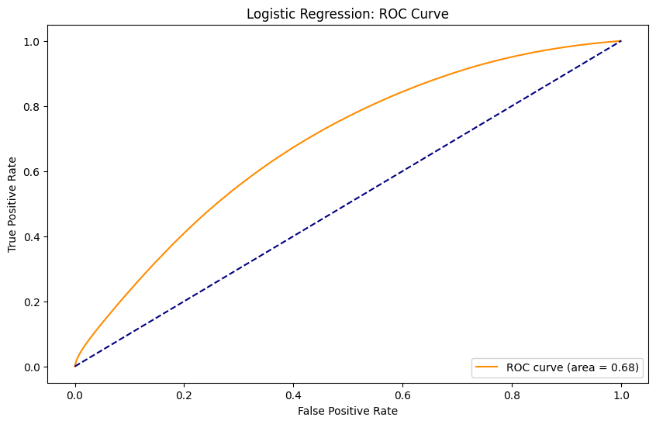
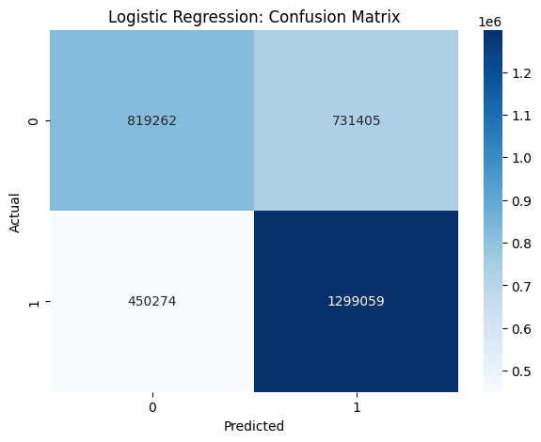

Slide 9
Our DNNs

Slide 10
Model Selection
Skorch & Optuna to run Random Grid Search on CUDA
Parameter Grid
Activation Functions: ReLU, LeakyReLU, Tanh
# of Linear + Activation Layer Pairs
Input/output sizes for hidden layers
Maximum Number of Epochs
Batch Size
Best Model:
250 Epochs | Batch Size of 200
6 Linear Layers, 5 LeakyReLU after first five Linear Layers, Sigmoid after last Linear Layer
Input/Output Sizes: 28>112>56>28>14>7>1

Slide 11
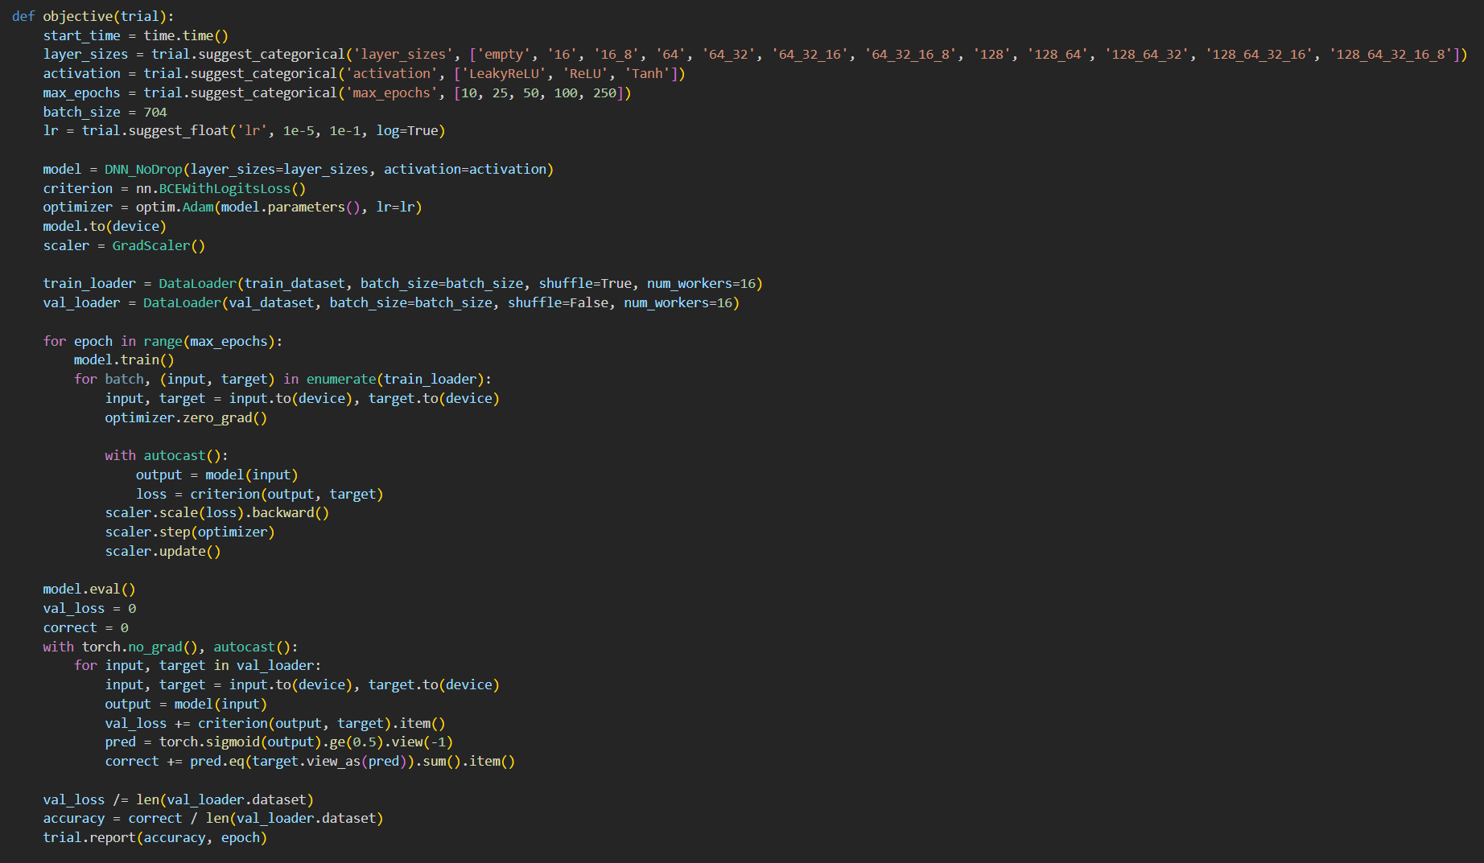
Optuna

Slide 12
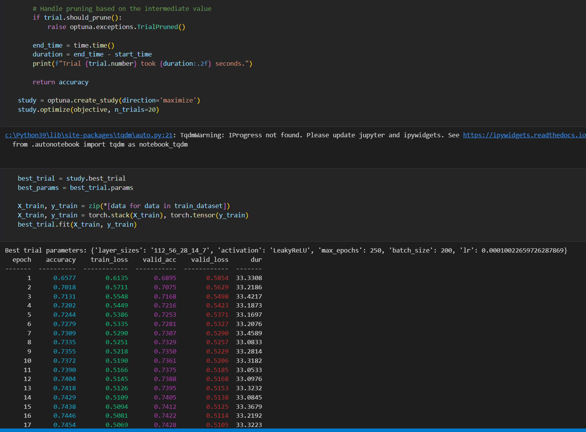
Optuna
Notes:
Pruning -> Automated early stopping

Slide 13
Models Tested
LeakyReLu w/ Dropout
Has Linear, Dropout, LeakyReLu, and Sigmoid activations
LeakyReLu w/o Dropout
Has Linear, LeakyReLu, and Sigmoid activations
LeakyReLu w/o Dropout (threshold adjusted)
Has Linear, LeakyReLu, and Sigmoid activations
Tanh w/ Dropout
Has Linear, Dropout, Tanh, and Sigmoid activations

Slide 14
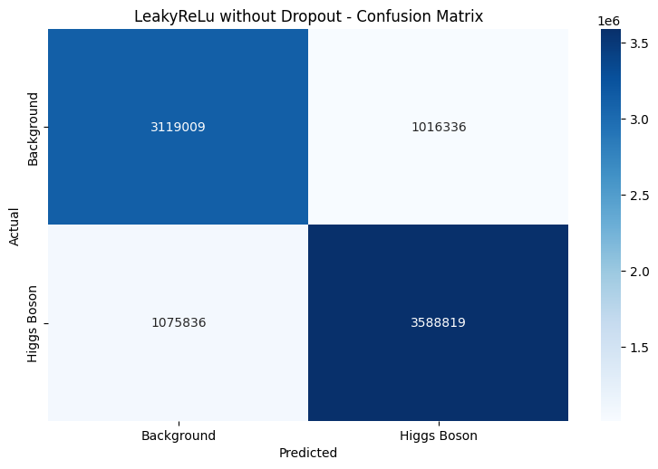
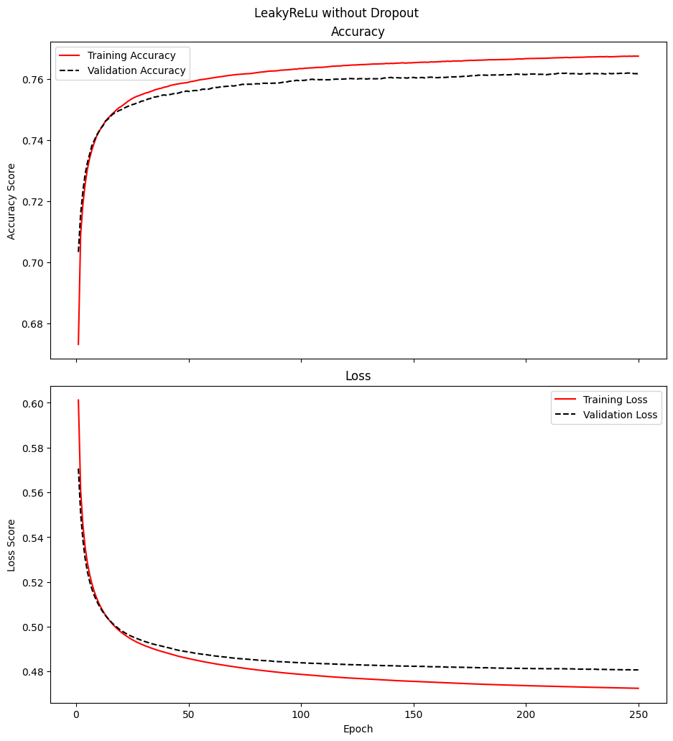
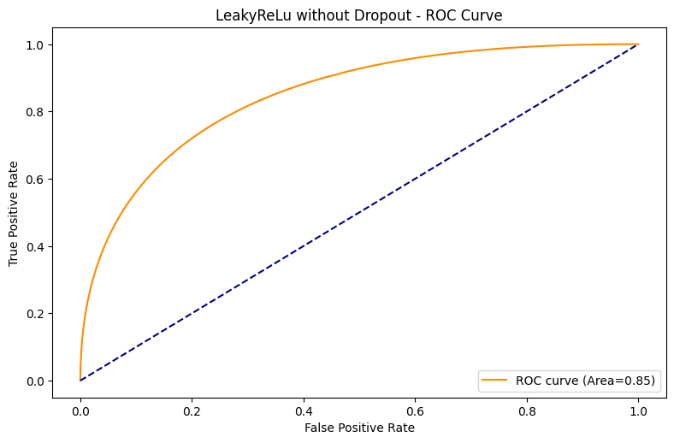
Original Model
Notes:
Accuracy for class 0: 0.7435
Accuracy for Class 1: 0.7793

Slide 15
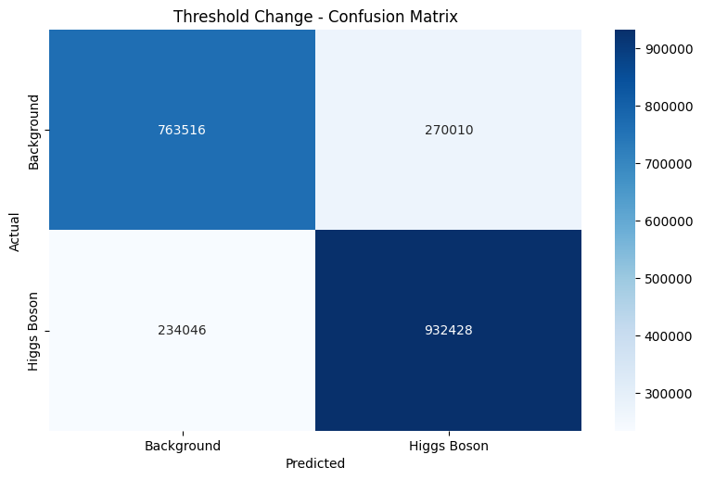
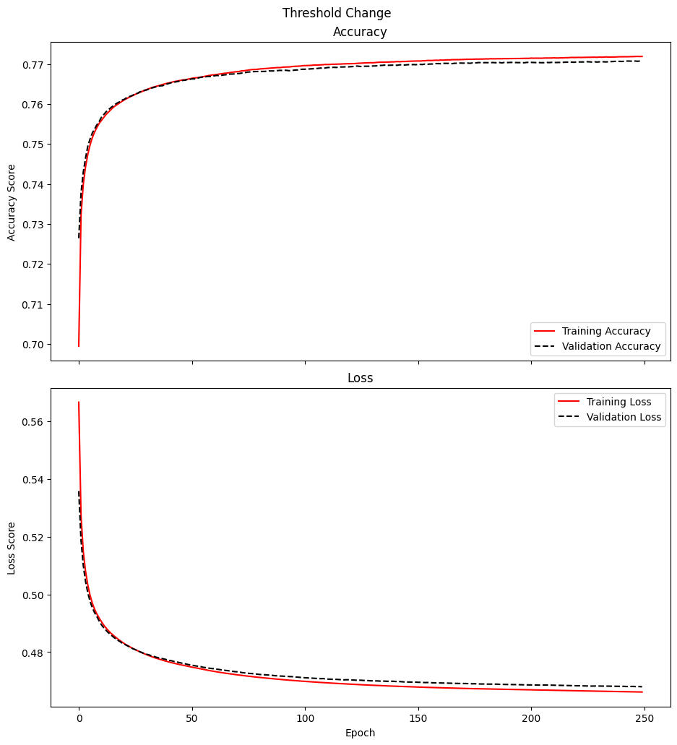
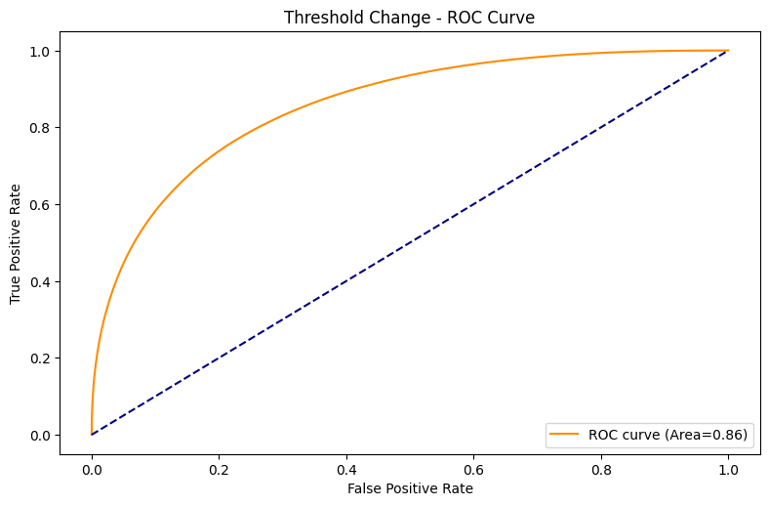
Threshold Change
Notes:
Accuracy for class 0: 0.7654
Accuracy for Class 1: 0.7754

Slide 16

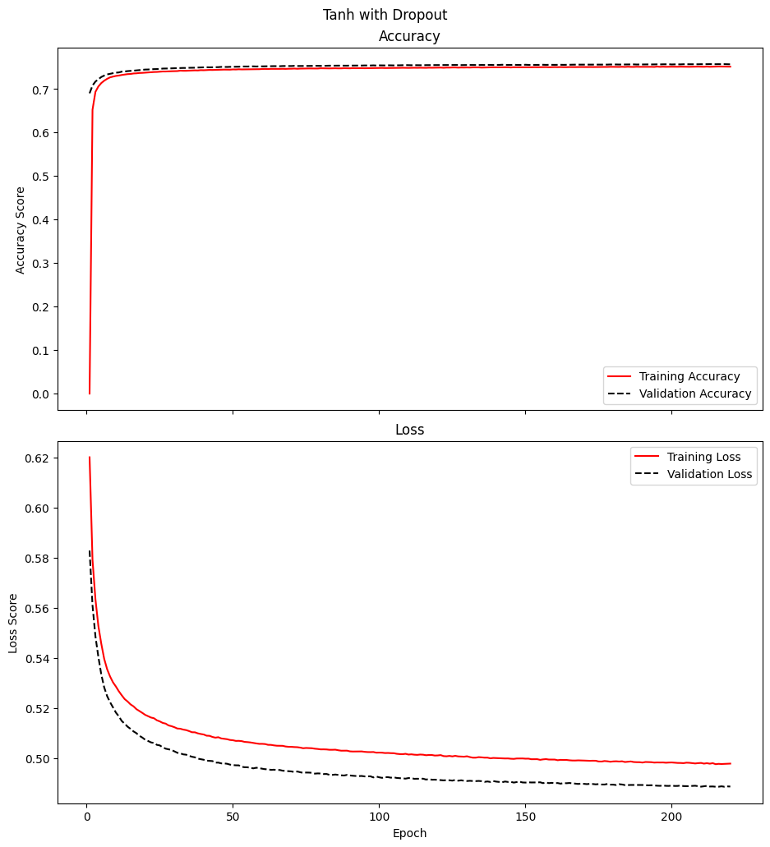

With Dropout and Tanh
Notes:
Accuracy for class 0: 0.7438
Accuracy for Class 1: 0.7685

Slide 17
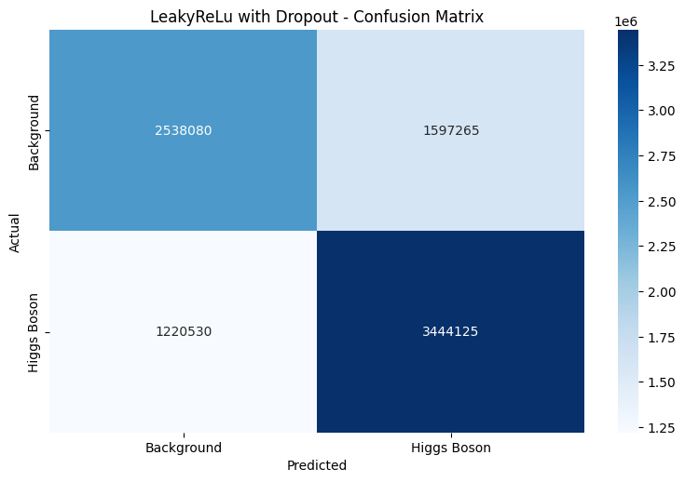
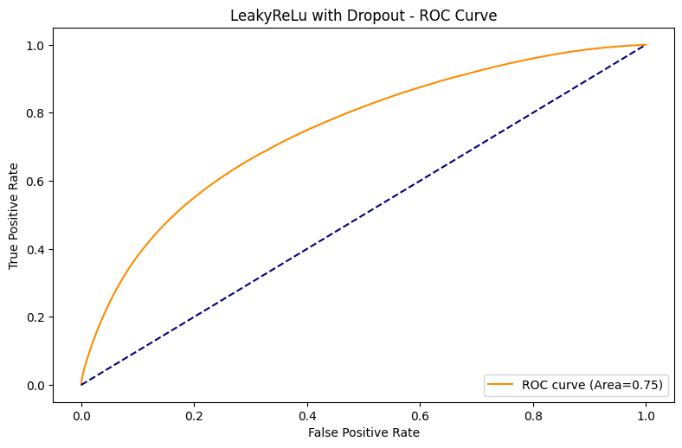
LeakyReLu With Dropout
Notes:
Accuracy for class 0: 0.6753
Accuracy for Class 1: 0.6832

Slide 18
Lessons Learned/Things to Improve On
Need more computing power (more powerful GPU or CPU)
20 hour hyperparameter tuning time
2+ hours per model fitting
In a production environment could use parallel/distributed systems
More efficient GPU coding
Optuna Framework
Domain-knowledge expert

Slide 19
Thank you.

